Slide 1
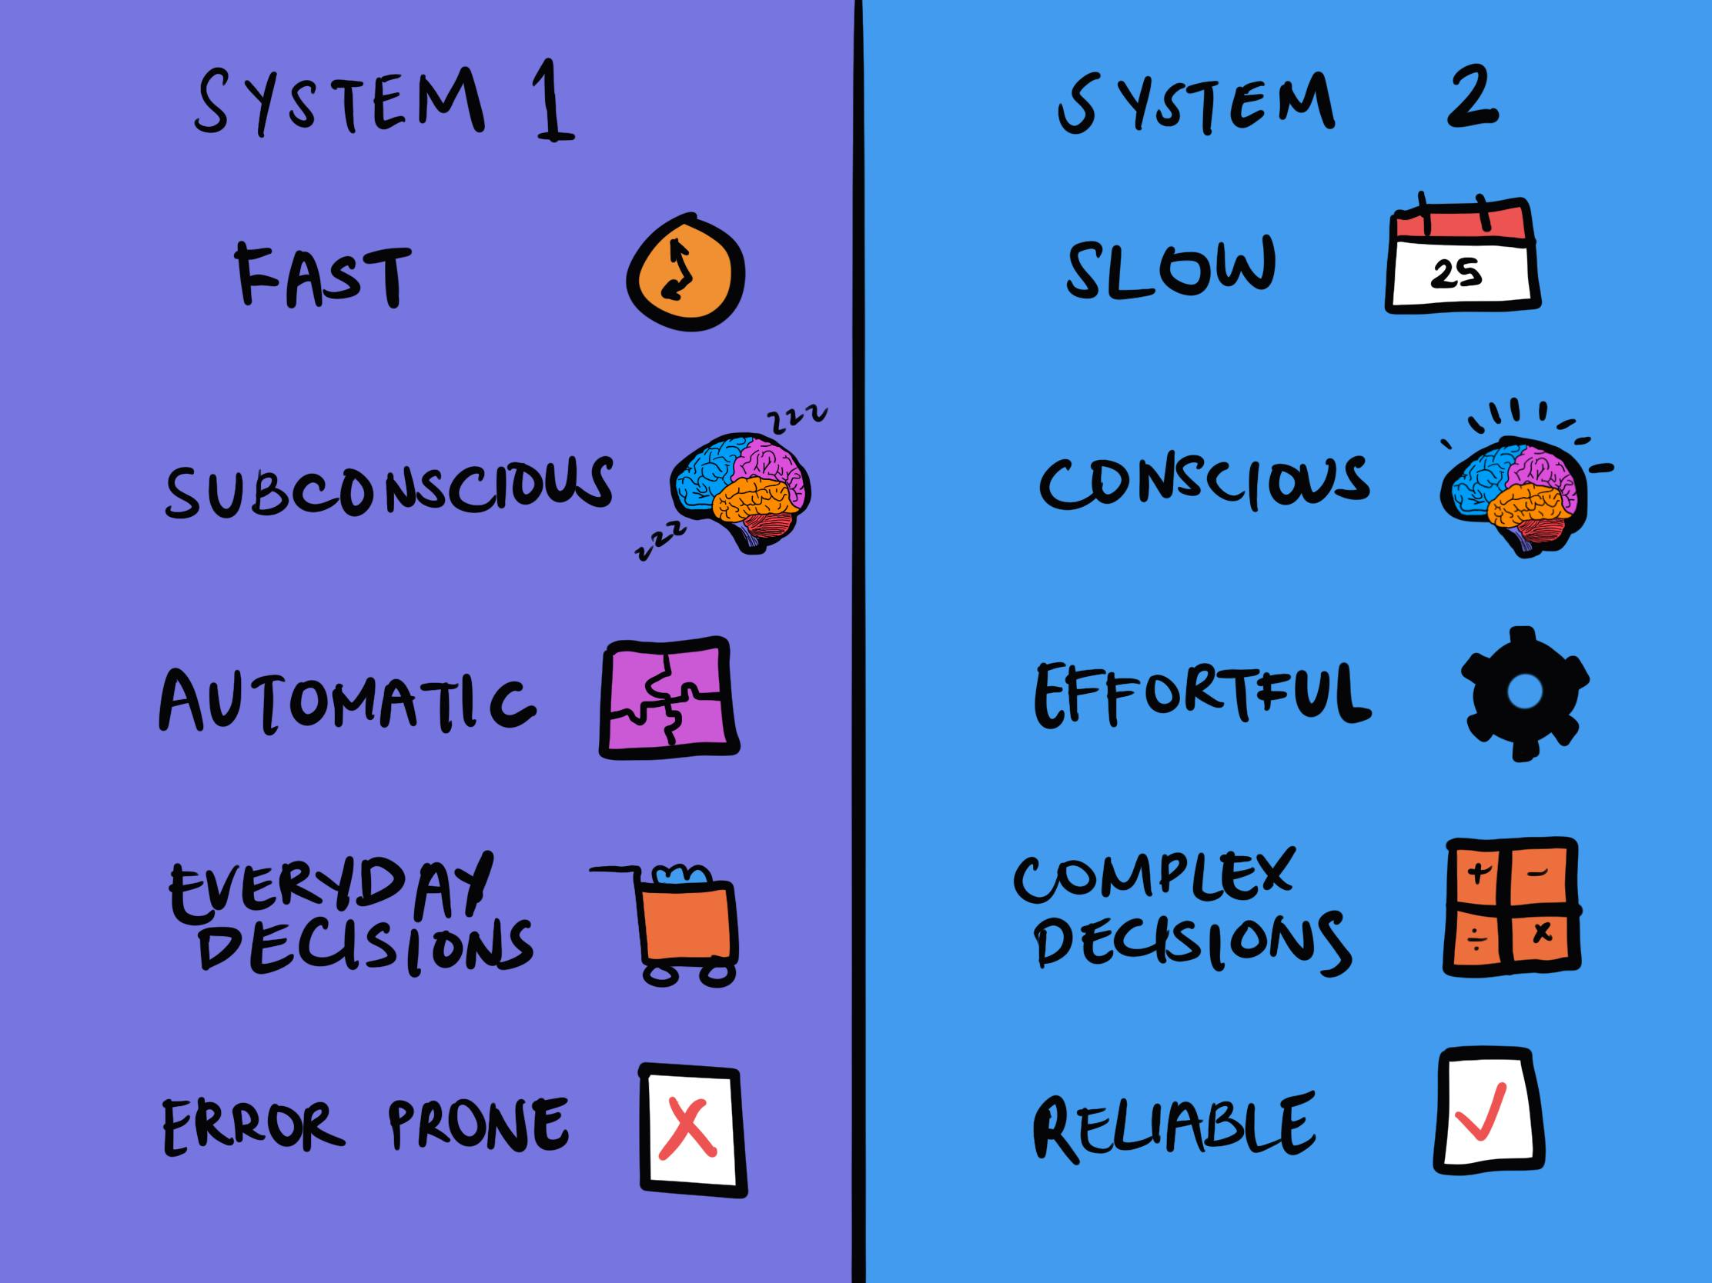
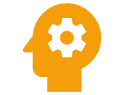
Logical Fallacies and
Cognitive Biases
Mastering Critical Thinking for Better Decision-Making
Understanding the errors in our reasoning

Slide 2





Introduction to Logical Fallacies & Cognitive Biases
Common Logical Fallacies
Agenda
Common Cognitive Biases
Navigating the Landscape of Flawed Reasoning
Why They Matter
How to Identify and Avoid Them
?
Questions

Slide 3
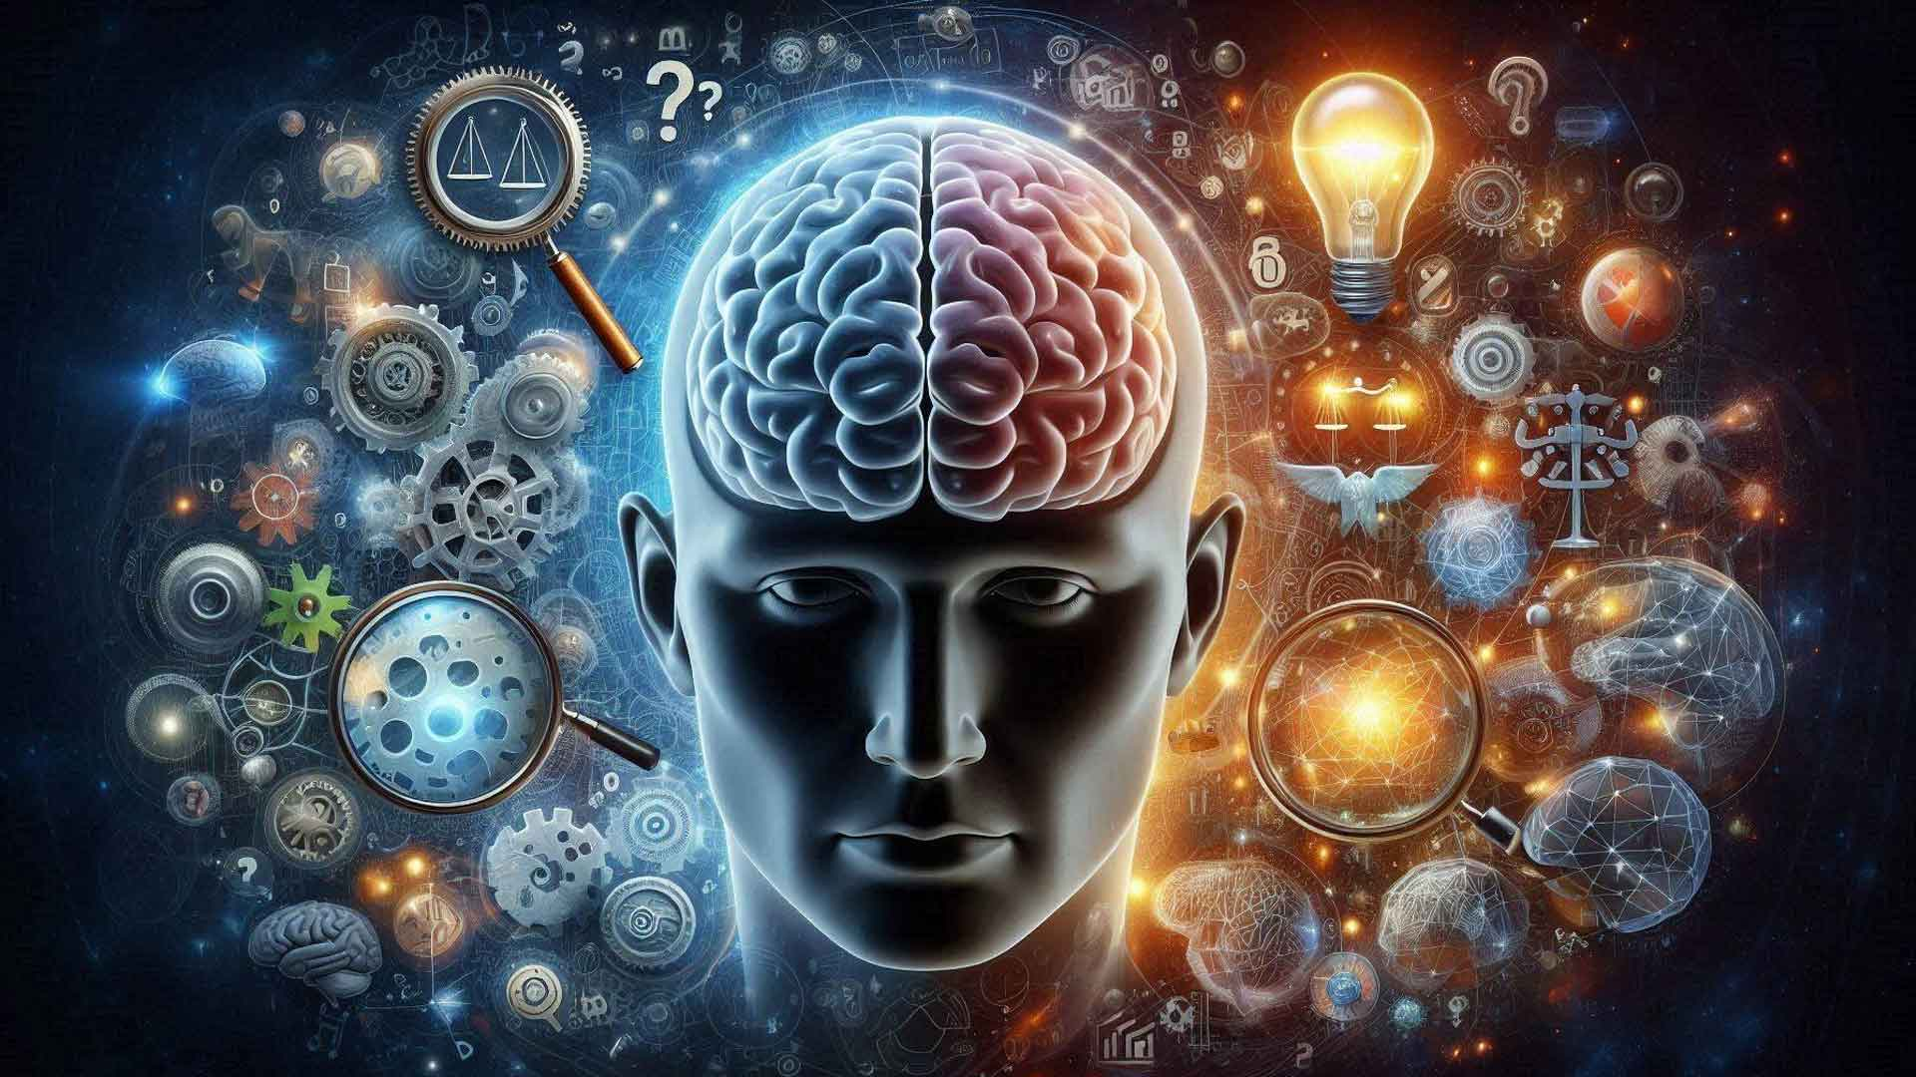





What Are They?
Logical Fallacies
Flaws in reasoning that weaken arguments and derail productive discussions
Cognitive Biases
Systematic errors in thinking that distort judgment and decision-making
Affect Decision-Making
Often Unconscious
Can Be Overcome

Slide 4
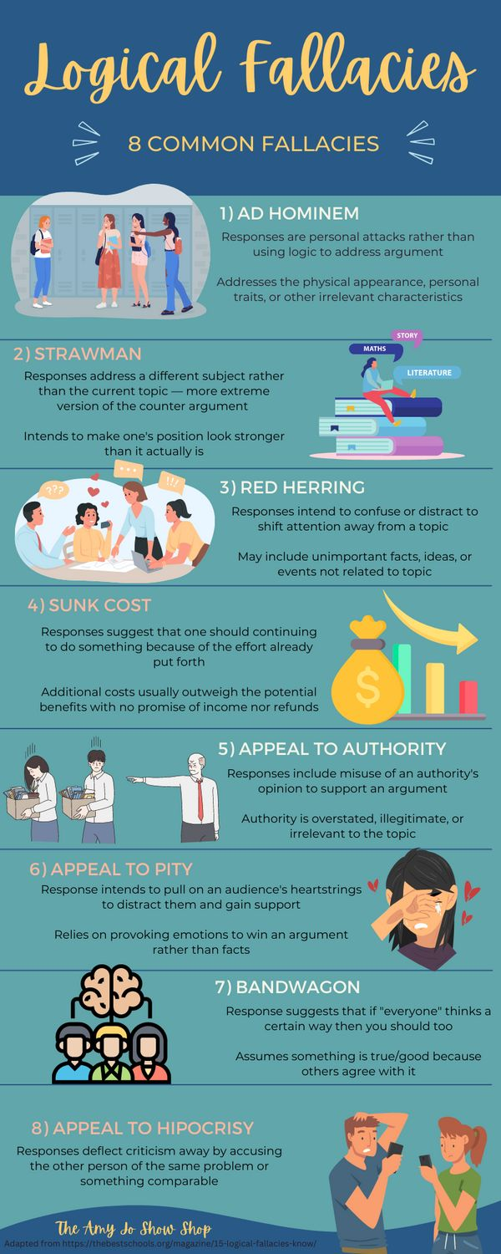

Logical Fallacies
Flaws in Reasoning That Weaken Arguments

Slide 5



Ad Hominem
Attacking the person instead of their argument
"You're wrong about climate change because you're not a scientist."
Common Fallacies
Strawman
Part 1 of 3
Misrepresenting the opponent's position
"You support healthcare? So you want government control of everything."
Spot them in daily life: Politics, media, social media, debates, and everyday conversations
Appeal to Authority
Relying on authority without evidence
"This skincare product works because a celebrity uses it."

Slide 6



Slippery Slope
Assuming one action leads to extreme consequences
"If we allow students to redo assignments, they'll never learn responsibility, and society will fall apart."
More Fallacies
Part 2 of 3
Circular Reasoning
Using the conclusion as evidence for the argument
Watch for these patterns: Unrealistic predictions, self-referencing arguments, and overbroad conclusions
"The law is right just because it's the law."
Hasty Generalization
Jumping to conclusions from limited evidence
"My neighbor's cat is mean. All cats must be mean."

Slide 7



False Dilemma
Red Herring
Additional Fallacies
Limiting options to only two
Changing the subject
"You're either with us or against us."
"Why worry about healthcare when we have crime?"
Part 3 of 3
Appeal to Emotion
Manipulating feelings
Master these to: Avoid manipulation and make clearer arguments
"If you care about family, buy this insurance."
Common in: Advertising, politics, social media, and debates

Slide 8
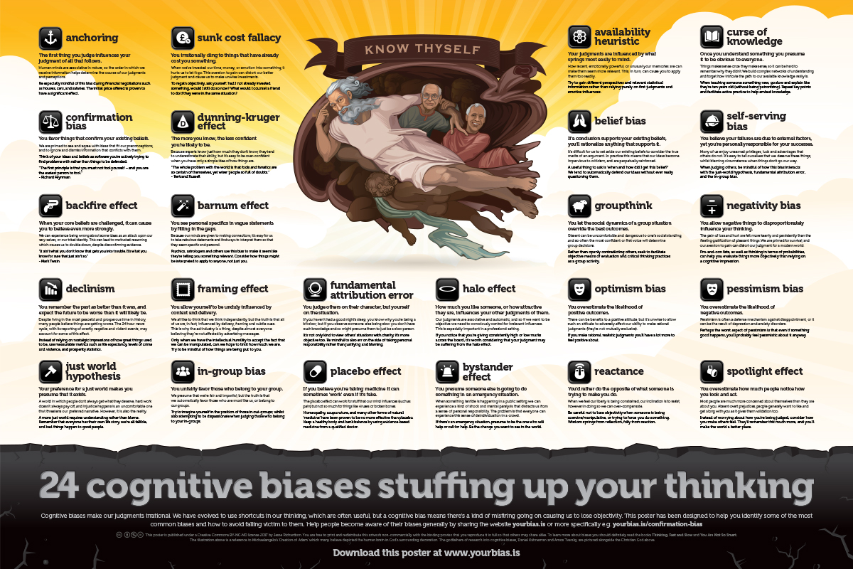

Cognitive Biases
Systematic Errors in Thinking
That Distort Judgment
150+ Types
Unconscious

Slide 9


Confirmation Bias
Favoring information that confirms existing beliefs
"I only follow news sources that reinforce my views."
Common Biases
Part 1 of 3
Hindsight Bias
Seeing events as more predictable after they happen
"I knew it all along!" (after seeing the outcome)

Slide 10


Actor-Observer Bias
Attribute our actions to external factors, others to internal
More Biases
"I'm late because of traffic, they're lazy"
Part 2 of 3
Halo Effect
Shape our reality: How we remember, judge, and interact with others
Overall impression influences judgment
"Attractive people rated more favorably"
Impact areas: Memory, relationships, hiring, and social interactions

Slide 11



Self-serving Bias
Claiming success but not failure
"I won because I'm smart, I lost because the referee was unfair."
Additional Biases
Part 3 of 3
Dunning-Kruger Effect
Unskilled overestimate ability, experts underestimate
"Novices think they know everything."
Universal patterns: Affect self-perception, learning, and emotional responses
Negativity Bias
Negative information has stronger impact
"One criticism outweighs five compliments."

Slide 12
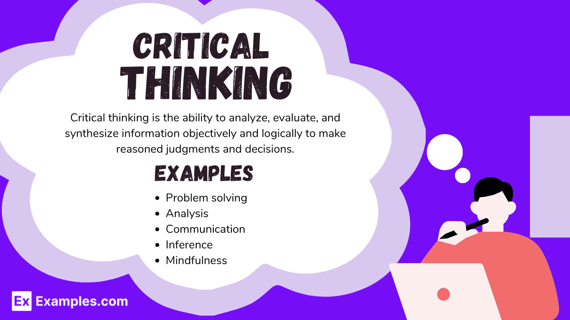
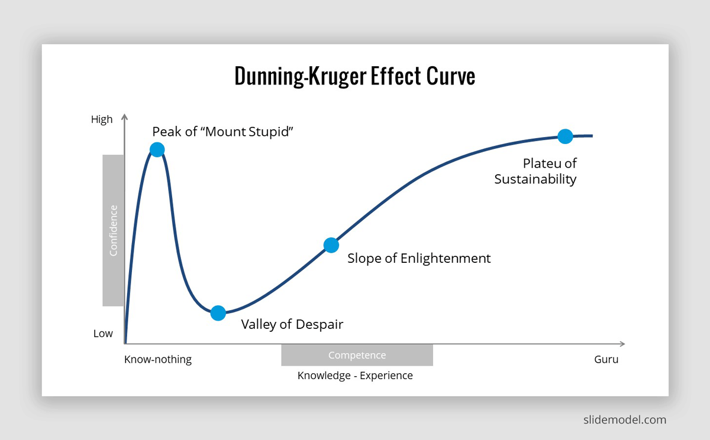
Mejor Grande del Mundo

Slide 13




Why They Matter
Improve Critical Thinking
Develop sharper analytical skills and clearer reasoning
Make Better Decisions
Choose more rationally and avoid costly mistakes
Avoid Manipulation
Recognize when others use fallacies to mislead
Communicate Effectively
Reduce Conflicts
Understand different perspectives
Persuade with logic, not tricks

Slide 14


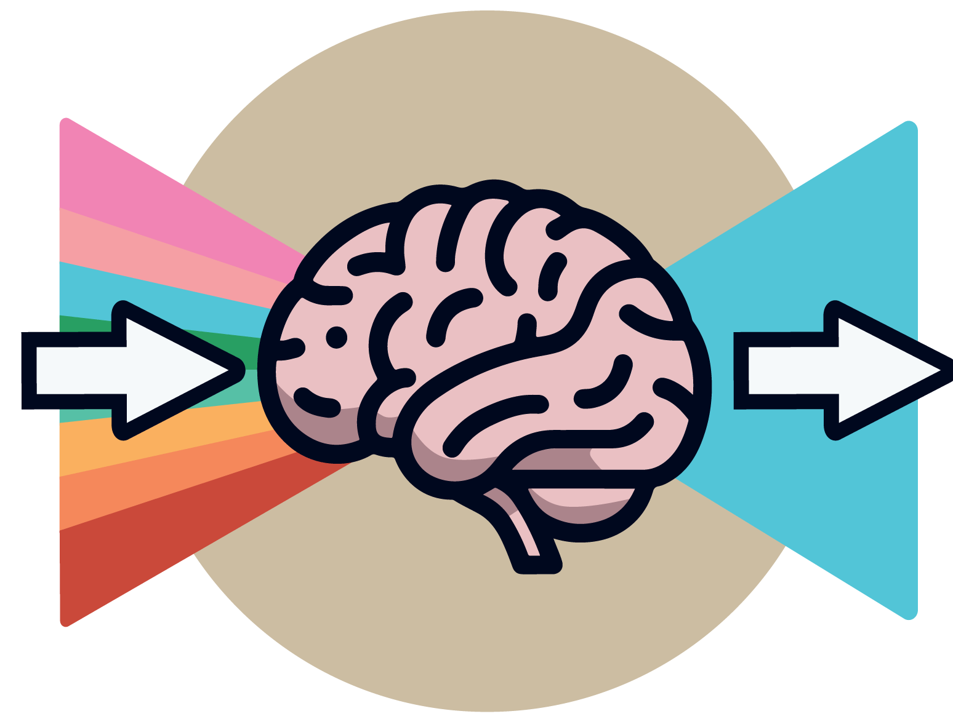






How to Identify & Avoid
Practical Strategies
Be Aware
Question Beliefs
Acknowledge we all have biases
Challenge your own opinions
Seek Diversity
Gather Data
Explore opposing views
Evidence before conclusions
Focus on Logic
Be Flexible
Over emotional manipulation
Practice cognitive flexibility
Slow Down
Learn from Mistakes
Think before deciding
Growth through errors
Awareness is the first step toward better thinking

Slide 15

“
The first principle is that you must not fool yourself — and you are the person easiest to fool.
— Richard Feynman, Nobel Laureate

Slide 16


Thank You
Questions & Discussion
Mastering critical thinking is a journey, not a destination. Stay curious, question assumptions, and keep learning.
Think Critically
Keep Improving

